Slide 1
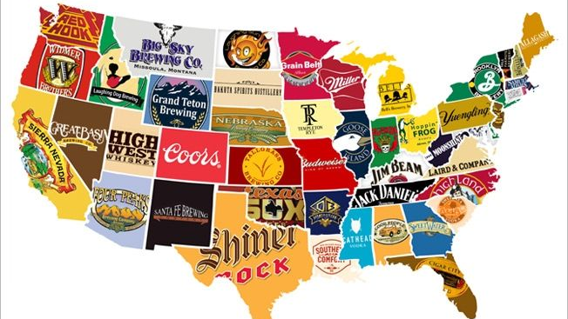
Where next for Budweiser brewery?
Finding an untapped market
DS 6306 Project 1
Eric Cadena and Tricia Herrera
6/26/2021

Slide 2
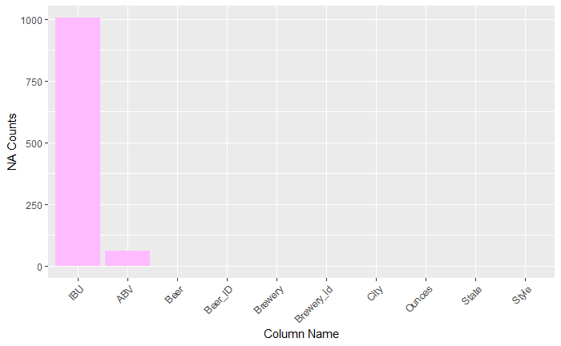
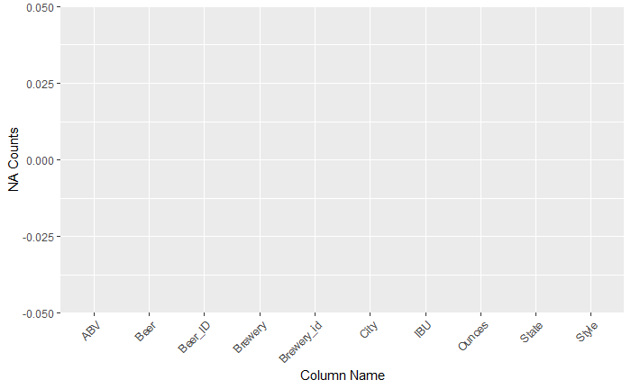
Address the missing values in each column.
In place of NA values for ABV or IBU, we used the Brewery ID's mean. In cases where there were no ‘Brewery ID’ mean available, we took the overall column mean.

Slide 3
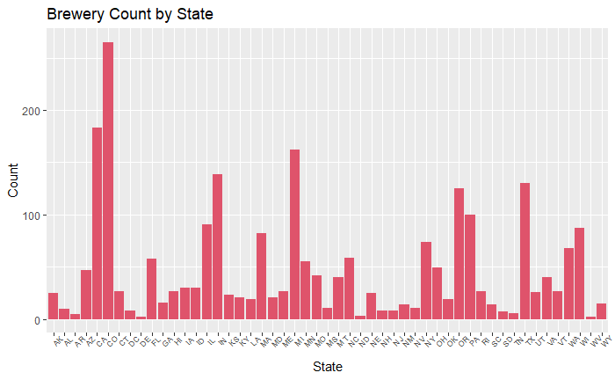
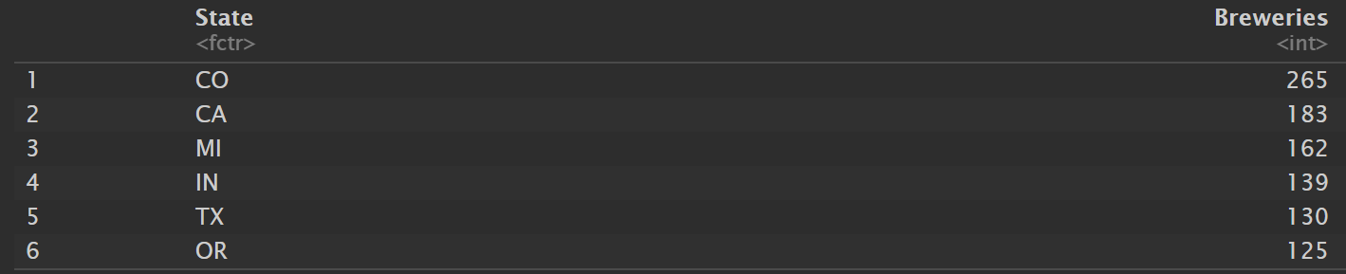

How many breweries are present in each state?

Slide 4
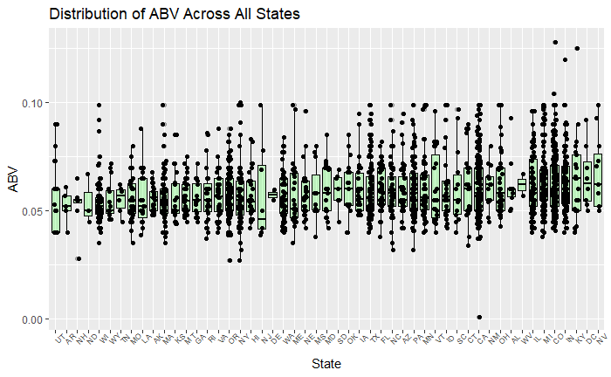

Comment on the summary statistics and distribution of the ABV variable?

Slide 5
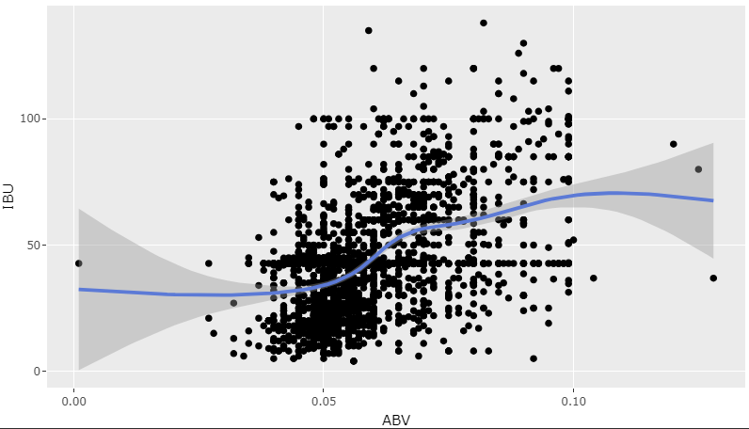

Is there an apparent relationship between the bitterness of the beer and its alcoholic content? Draw a scatter plot. Make your best judgment of a relationship and EXPLAIN your answer.
As alcohol content increases, the bitterness of beer increases. This is not a one to one correlation but the trend, as shown by the regression line suggests a relationship between ABV and IBU.

Slide 6
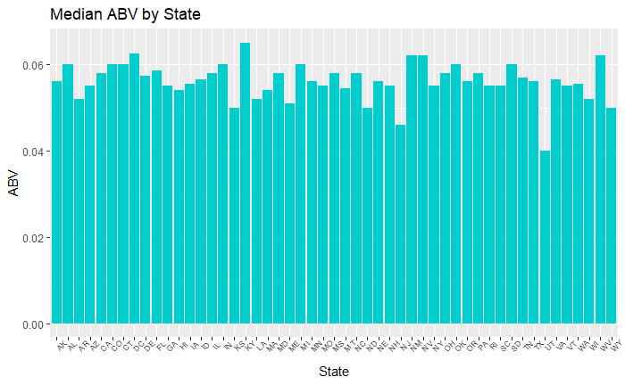
Compute the median alcohol content and international bitterness unit for each state. Plot a bar chart to compare.
The state with the highest median alcohol content is Kentucky and the state with the lowest median alcohol content is Utah.

Slide 7
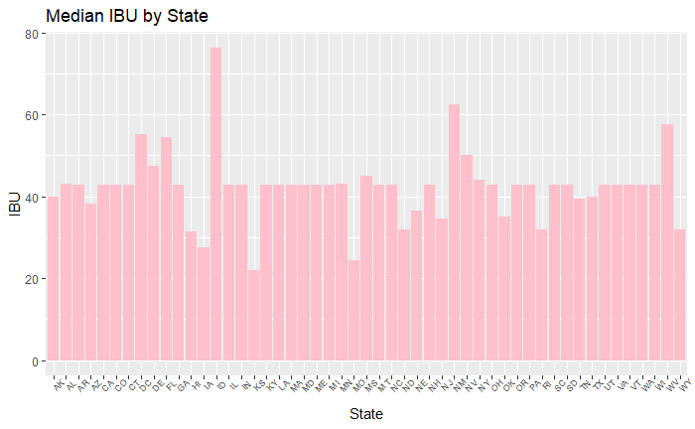
Compute the median alcohol content and international bitterness unit for each state. Plot a bar chart to compare.
The state with the highest median international bitterness unit Kansas and the state with the lowest median international bitterness unit is Idaho.

Slide 8
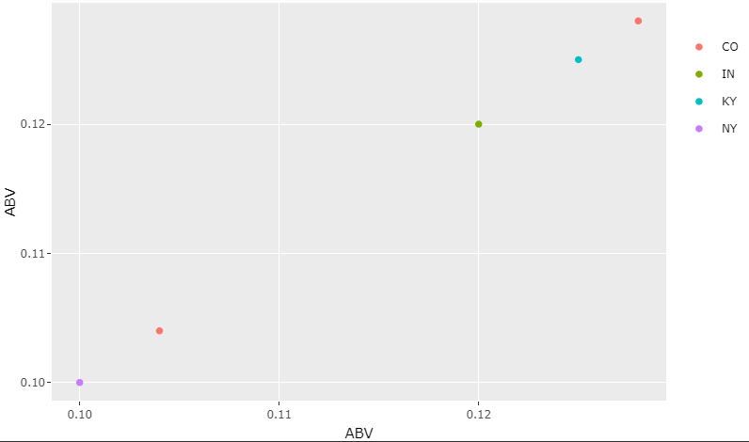
Which state has the maximum alcoholic (ABV) beer?
Colorado’s Lee Hill Series vol.5-Belgian Style Quadrupel Ale has the highest Alcohol by Volume (ABV), at 12.8%

Slide 9
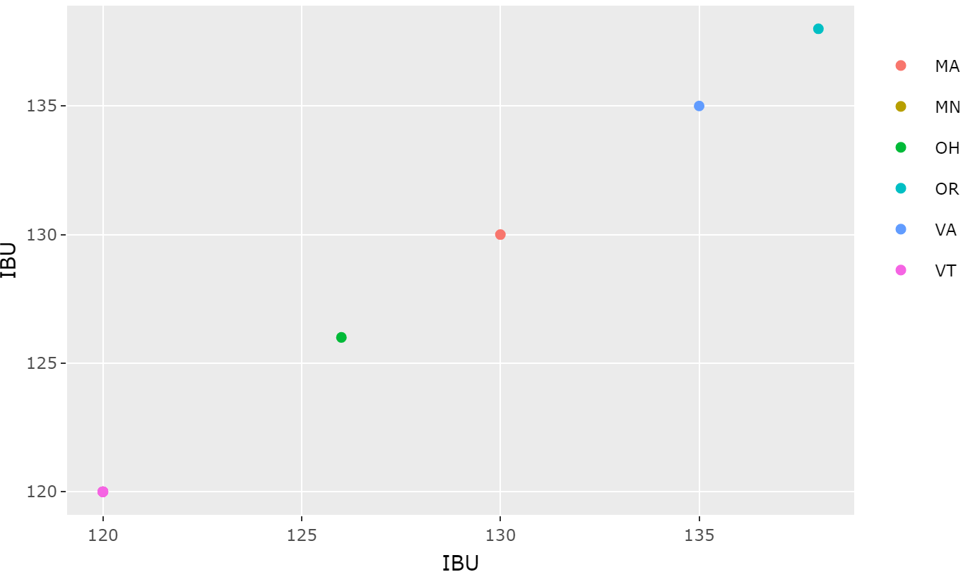
Which state has the most bitter (IBU) beer
Oregon’s Bitter Bitch Imperial IPA has the highest International Bitterness Units (IBU), at 138.

Slide 10
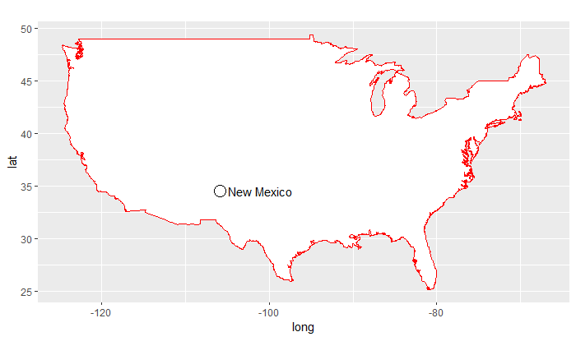
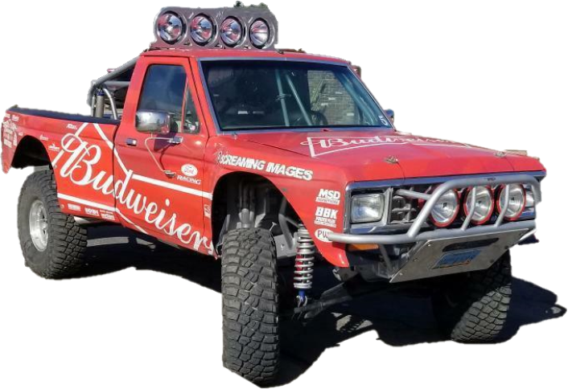
Our recommendation to Budweiser
Description | Values
State Count | 14 (< 1%)
ABV | 6.2%
IBU | 62.5

Slide 11
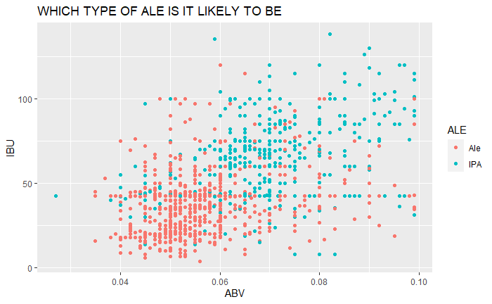
Budweiser would like to investigate the difference with respect to IBU and ABV between IPAs (India Pale Ales) and other types of Ale. Use a KNN classification to investigate this relationship. Provide statistical evidence one way or the other.
83% chance that the beer is an IPA at K=5 and an 82.6% chance that the beer is an IPA at K=15

Slide 12
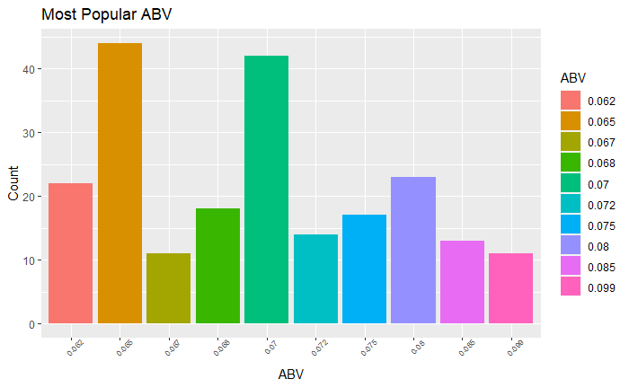
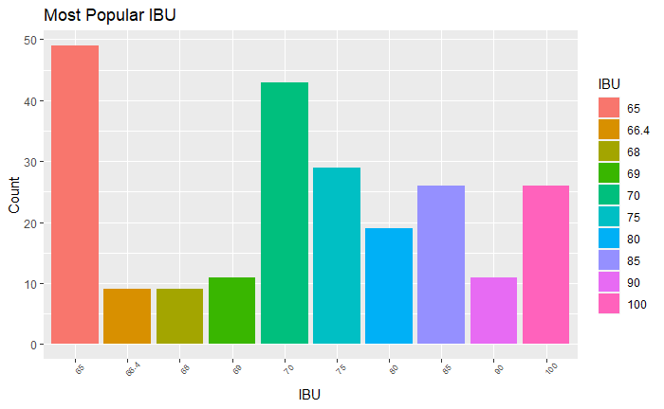
Supplement your response to this question with any other methods or techniques you have learned
If you run a Naïve Bayes on the most popular ABV (.065) & the most popular IBU (65), there is a 60% chance the beer will be an IPA. If you run a Naïve Bayes on the 2nd most popular ABV (.07) and the 2nd most popular IBU (70), there is a 78% chance it will be an IPA. If we want to break records with our limited edition and compete with both Oregon (138 IBU) and Colorado (12.8% Alcohol by Volume), according to Naïve Bayes, we should DEFINITELY CREATE AN IPA.

Slide 13
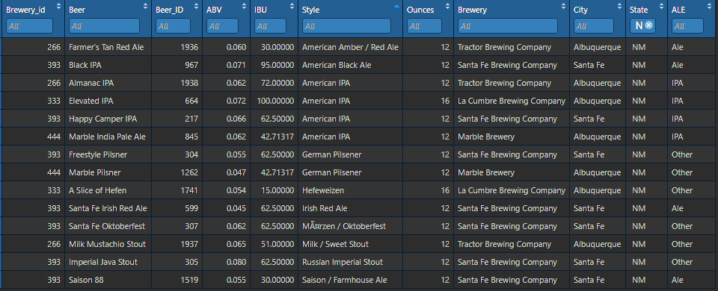
Find one other useful inference from the data that you feel Budweiser may be able to find value in
Less than 30% of New Mexico’s beer styles are an American IPA.

Slide 14
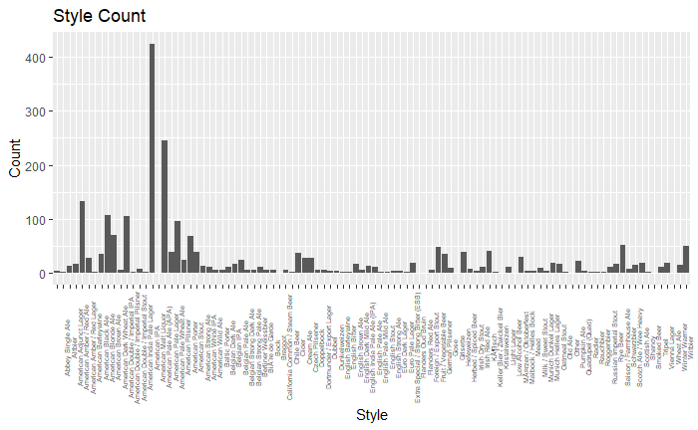
Find one other useful inference from the data that you feel Budweiser may be able to find value in
The American IPA is the most popular style of beer in the country.

Slide 15
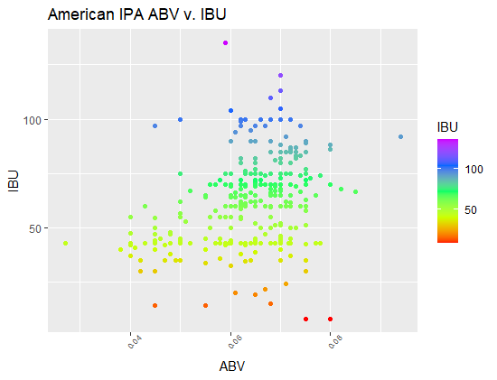
Find one other useful inference from the data that you feel Budweiser may be able to find value in
65
0.065
98 Problems (Cuz A Hop Ain't One) by Perrin Brewing Company has an ABV of 6.5% (> ABV median) and IBU of 65 ( > IBU median).

Slide 16
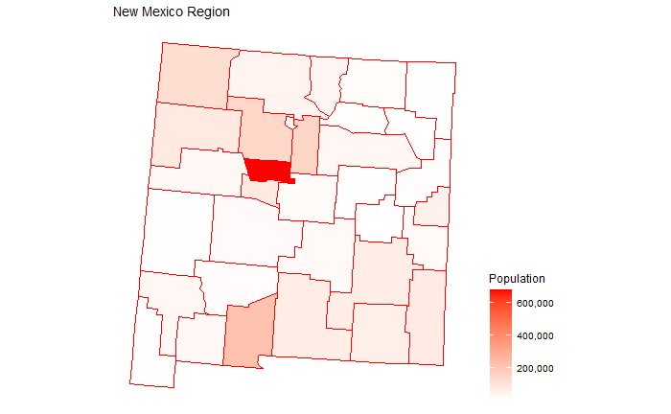
summary
The untapped market we would like to explore is New Mexico.
They have less than 1% of all Breweries and their citizens tastes are a perfect match for a higher ABV and IBU beer
Our new flagship beer should be an IPA because it is not only the most popular American beer, but it also fits our ABV and IBU range and it is an underrepresented beer in New Mexico.
0.065

Slide 17
YOUTUBE Links:
Tricia Herrera YouTube Link: https://www.youtube.com/watch?v=tUrTIKhdiFc
Eric Cadena YouTube Link: https://youtu.be/oq6OGRkdcd8
GITHUB LINK:

